Slide 1
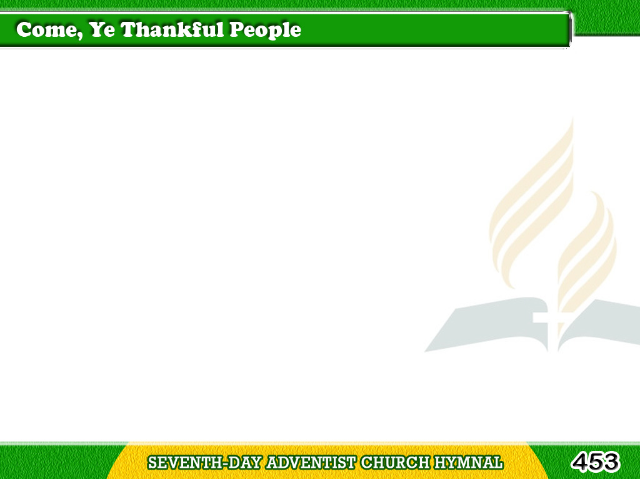
1/4
Come, ye thankful people, come,
Raise the song of harvest home!
All is safely gathered in,
Ere the winter storms begin;
Parito, Kayo Bayan p.454
Tagalog
Version

Slide 2
1/4
God, our Maker, doth provide
For our wants to be supplied;
Come to God’s own temple, come;
Raise the song of harvest home!
Tagalog
Version

Slide 3
2/4
We ourselves are God’s own field,
Fruit unto His praise to yield;
Wheat and tares together sown,
Unto joy or sorrow grown;
Tagalog
Version

Slide 4
2/4
First the blade and then the ear,
Then the full corn shall appear;
Grant, O harvest Lord, that we
Wholesome grain
and pure may be.
Tagalog
Version

Slide 5
3/4
For the Lord our God shall come,
And shall take His harvest home;
From His field shall purge away
All that doth offend, that day;
Tagalog
Version

Slide 6
3/4
Give His angels charge at last
In the fire the tares to cast,
But the fruitful ears to store
In His garner evermore.
Tagalog
Version

Slide 7
4/4
Then, thou church
triumphant, come,
Raise the song of harvest home;
All are safely gathered in,
Free from sorrow, free from sin;
Tagalog
Version

Slide 8
4/4
There forever purified
In God’s garner to abide;
Come, ten thousand angels, come,
Raise the glorious harvest home!
Tagalog
Version

